Slide 1
Lesson 10: The laplace Transform
ET 438a Automatic Control Systems Technology

Slide 2
Learning Objectives
After this presentation you will be able to:
Explain how the Laplace transform relates to the transient and sinusoidal responses of a system.
Convert time functions into the Laplace domain.
Use Laplace transforms to convert differential equations into algebraic equations.
Take the Inverse Laplace transform and find the time response of a system.
Use Initial and Final Value Theorems to find the steady-state response of a system.

Slide 3
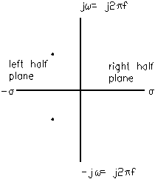
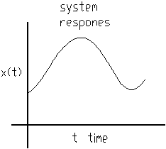
The Laplace Transform
Laplace transform converts time domain problems into functions of a complex variable, s, that is related to the frequency response of the system
Laplace
Transform
Time domain
Complex frequency

Slide 4
Complex Frequency and The Laplace Transform
Complex frequency combines transient response with sinusoidal steady-state response to get total response of system to input
a.
Complex Frequency
σ = exponential decay/increase constant that is
related to time constants of systems transient response. RC = L/R = σ in circuit analysis
b.
a.) Higher frequency
b.) Faster time constants

Slide 5
Sinusoidal Response From Complex Frequency
The radian frequency ω = j2πf same frequency used in phasor analysis
Laplace related to sine response through Euler's Identity. Euler's relates complex exponentials to sine and cosine time functions
Adding and subtracting the above relationships gives the exponential forms of sine and cosine

Slide 6
Exponential Forms of Sinusoids
Add the identities
Subtract the identities
+
-
Exponential form of Cosine
Exponential form of Sine
Since
Laplace can give complete response: dc transient and steady-state sinusoidal

Slide 7
Basic Laplace Transform Pairs
Time Domain Function
Laplace Domain Function
Note: time functions multiplied by constants give
Laplace function multiplied by constant
Examples:

Slide 8
Laplace Transform Examples
Match the following time functions to correct Laplace domain function using the transform pairs.
a.)
1
1
3
3
Laplace table
3.2 textbook
b.)
4
4
2
2
c.)
5
5
d.)
e.)

Slide 9
Laplace Theorems
Laplace of an unknown function
Capitalize unknown function name
Replace t with s
Examples
Laplace Operator
Symbol
Linearity of transform - can multiply by constant

Slide 10
Laplace Transforms of Calculus Operators
Laplace Transform turns derivative into multiplication by s
Subtract any non-zero initial conditions
For higher order derivatives
0 initial conditions reduces formula to

Slide 11
Laplace Transforms of Calculus Operators
Laplace turns integration into division by s
Examples from circuit analysis:
Capacitor voltage

Slide 12
More Examples From Circuit Analysis
Find the Laplace relationship for inductor voltage
Laplace relationship for resistor voltage

Slide 13
Laplace Transforms and Impedance
Remember phasor analysis is only valid for sinusoidal steady-state. Turns ac analysis into an analysis similar to the dc. (Ohm's law)
Since Laplace variable represents frequency, it's possible to replace jω with s and s with jω. If s is replaced with jω, analysis reverts to phasors We can find the frequency response of a dynamic system by converting differential equation into Laplace domain and replacing s with jω. Sweeping frequency produces Bode plot of system.

Slide 14
Laplace Transforms and Impedance
Laplace “Impedances” (Ohm’s Law)
Impedance (Phasors)
Inductors
Inductors
Capacitors
Capacitors
Resistors
Resistors

Slide 15
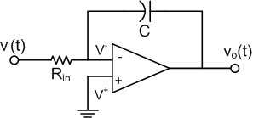
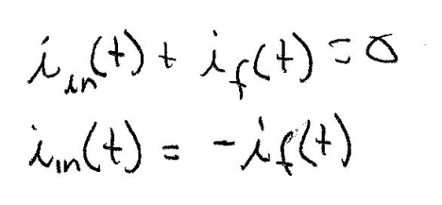
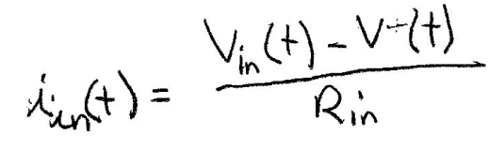
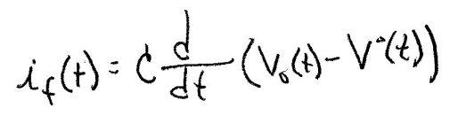

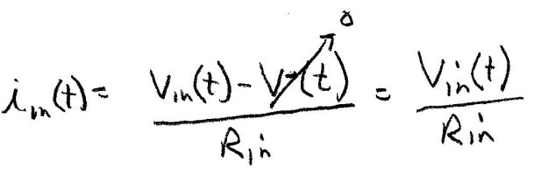
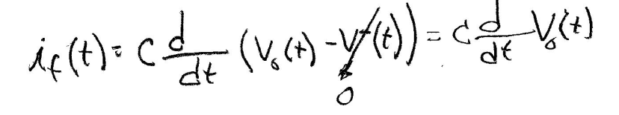
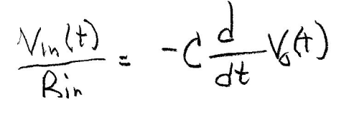
Laplace Representations of OP AMP Circuits
Find I/O relationship of integrator using Laplace relationships
I_{f}(t)
Use OP AMP theory and solve. No I enters inverting node and V⁺=V⁻=0 due to ground connection.
I_{in}(t)
Use KCL at inverting node
KCL
Substitute into
KCL equation

Slide 16

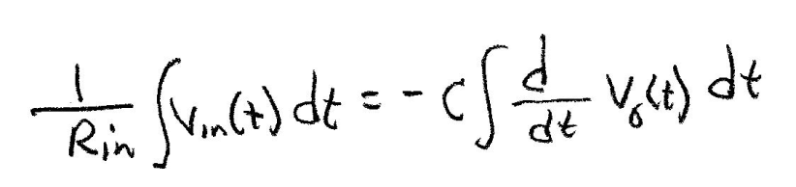
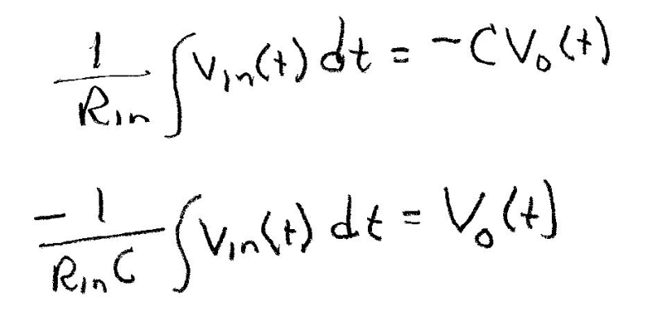
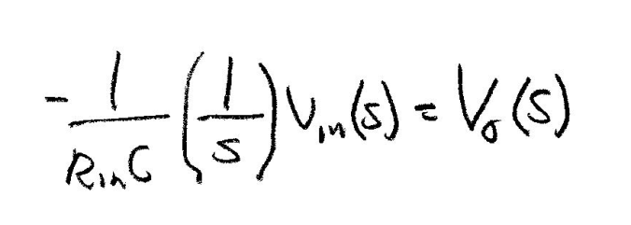
Laplace Representations of OP AMP Circuits
Integrate both sides of above equation to get V_{o}(t). Integration is inverse of differentiation
Can use generalized gain formula of inverting OP AMP and Laplace Impedances
Take
Laplace of Equation

Slide 17
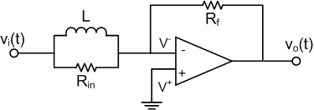
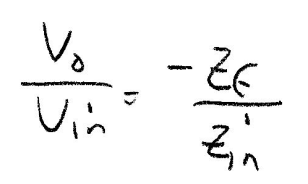
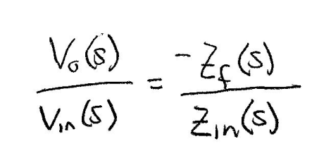
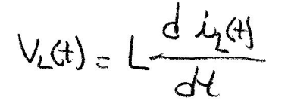
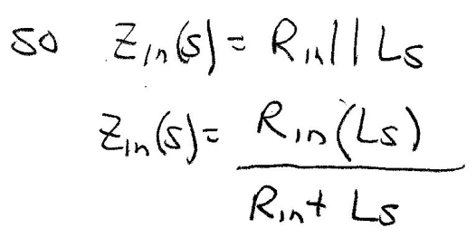
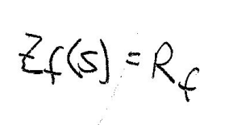
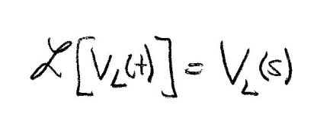
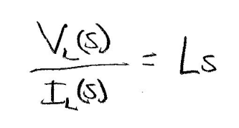
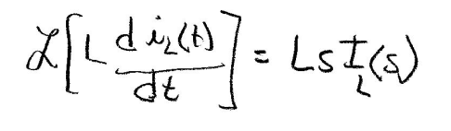
Laplace Representations of OP AMP Circuits
Example 10-1: Find the input/output relationship for the circuit shown below.
Generalized gain formula
Use Laplace impedance relationships to find gain
For inductor

Slide 18
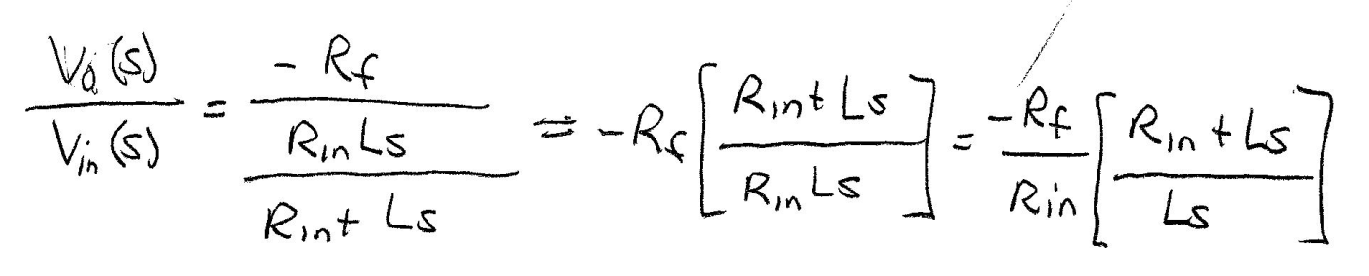
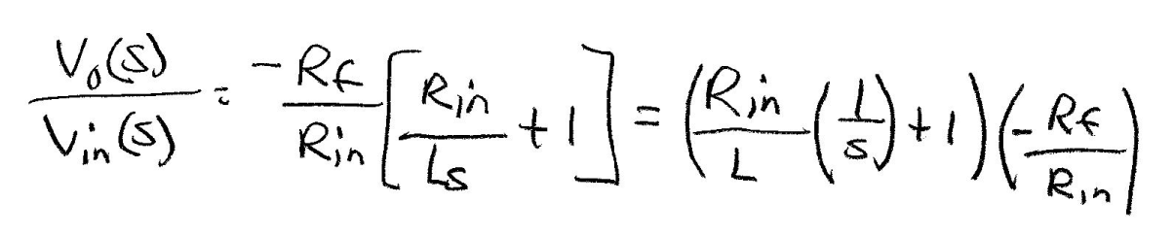
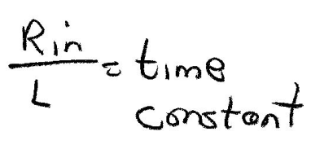
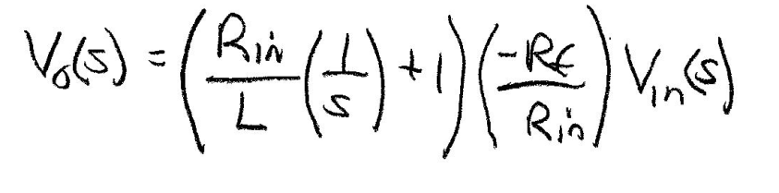
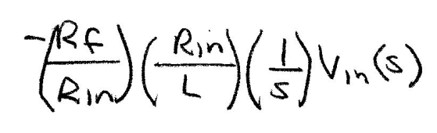
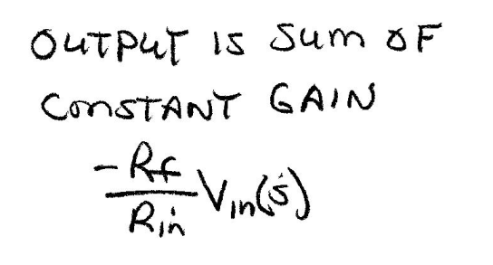
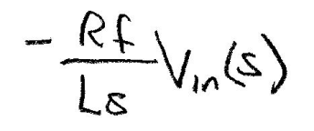
Example 10-1 Solution (2)
Substitute into generalized gain formula
And integrator
action
Division by s means
Integration in time

Slide 19
ET 438a Automatic Control Systems Technology
End Lesson 10: The Laplace Transform

